Slide 1

Big Words Don’t Come Cheap Project CyberSym I An Agent-Based Simulation of Multi-Stage Production Processes Janosch Haber Supervisor: Dr. Roberto Valenti

Slide 2
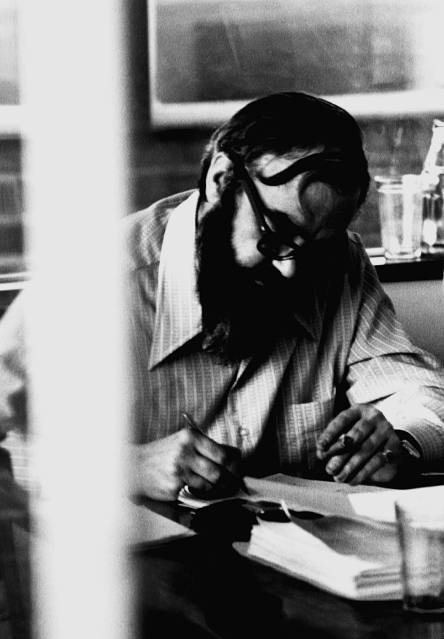
Stafford Beer (1959)
All viable systems are necessarily adaptive and self-regulating
Management Cybernetics
1

Slide 3
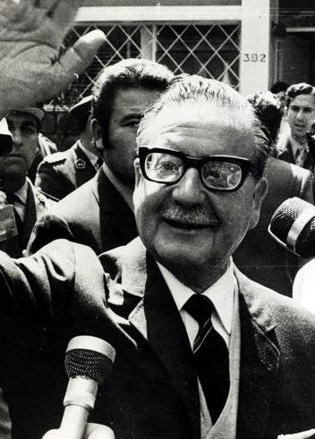
Salvador Allende (1970)
First elected socialist President of Chile
Nationalization of Industry
2

Slide 4
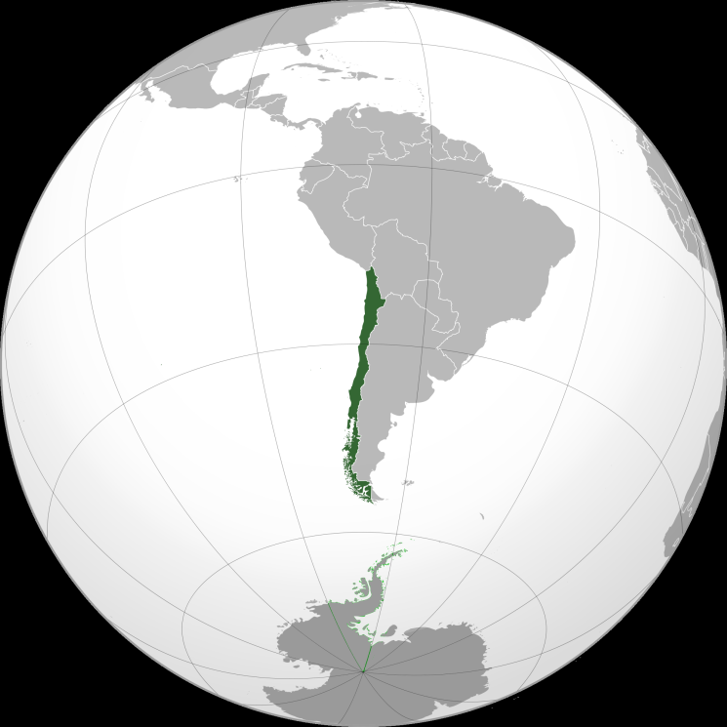
Salvador Allende (1970)
First elected socialist President of Chile
Nationalization of Industry
3
2

Slide 5

Project CyberSyn (1971)
Name from its main concepts: Cybernetics and Synergy
4

Slide 6
Project CyberSyn (1971)
Name from its main concepts: Cybernetics and Synergy
Cybernet. A network of telex machines
Cyberstride. Real-time statistical evaluation
CHECO. Economic Decision System
4

Slide 7

Project CyberSyn (1973)
Military Coup: The government is toppled, Allende is killed and the scientists working on CyberSyn are imprisoned
5

Slide 8
Project CyberSyn (1973)
Military Coup: The government is toppled, Allende is killed and the scientists working on CyberSyn are imprisoned
Project CyberSym: Under which parameter settings will an Agent-Based Simulation of Multi-Stage Production Processes adopt an optimal resource distribution network?
5

Slide 9
Project CyberSym
Cybernetics and Symbiosis
Multi-Stage Word-Building
APPLE
A
E
P
L

Slide 10
Project CyberSym
Cybernetics and Symbiosis
Multi-Stage Word-Building
APPLE
PP
LE
A
E
P
L

Slide 11
Project CyberSym
Cybernetics and Symbiosis
Multi-Stage Word-Building
APPLE
APP
PP
LE
A
E
P
L

Slide 12
Project CyberSym
Cybernetics and Symbiosis
Multi-Stage Word-Building
Agent-Based Simulation
APPLE
APP
PP
LE
A
E
P
L

Slide 13
Project CyberSym
Cybernetics and Symbiosis
Environment with Resources

Slide 14
Project CyberSym
Cybernetics and Symbiosis
Environment with Resources
Agents

Slide 15
Project CyberSym
Cybernetics and Symbiosis
Environment with Resources
Agents
Demand

Slide 16
Project CyberSym
Cybernetics and Symbiosis
Environment with Resources
Agents
Demand
Supply

Slide 17
Project CyberSym
Cybernetics and Symbiosis
Environment with Resources
Agents
Demand
Supply
Collaboration

Slide 18
Project CyberSym
Cybernetics and Symbiosis
Environment with Resources
Agents
Demand
Supply
Collaboration
Evaluation

Slide 19
Big Words Don’t Come Cheap Project CyberSym I Main research question: Under which parameter settings will an Agent-Based Simulation of Multi-Stage Production Processes adopt an optimal resource distribution network?

Slide 20
Image Sources
1) http://www.vanityfair.fr/uploads/images/201506/dc/vf_stafford_beer_2180.png
2) http://www.sbs.com.au/theother911/images/c7333e7d.allendeElection_800x554.jpg
3) http://img3.wikia.nocookie.net/__cb20110317013600/althistory/images/b/bf/Map_Chile_DD.png
4) http://proyectoidis.org/wp-content/uploads/2013/07/Project-Cybersyn051.jpg
5) http://www.hindustantimes.com/Images/2011/5/113a350f-15d0-4e13-9ff6-0e20f20b0456HiRes.JPG

